Slide 1


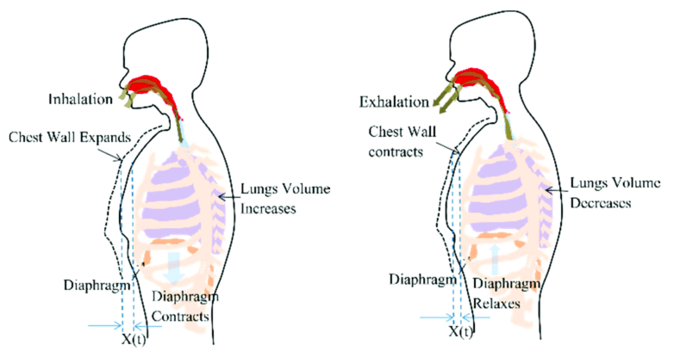

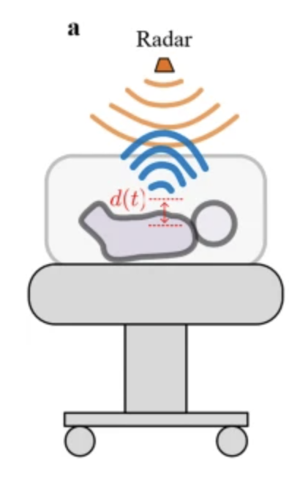
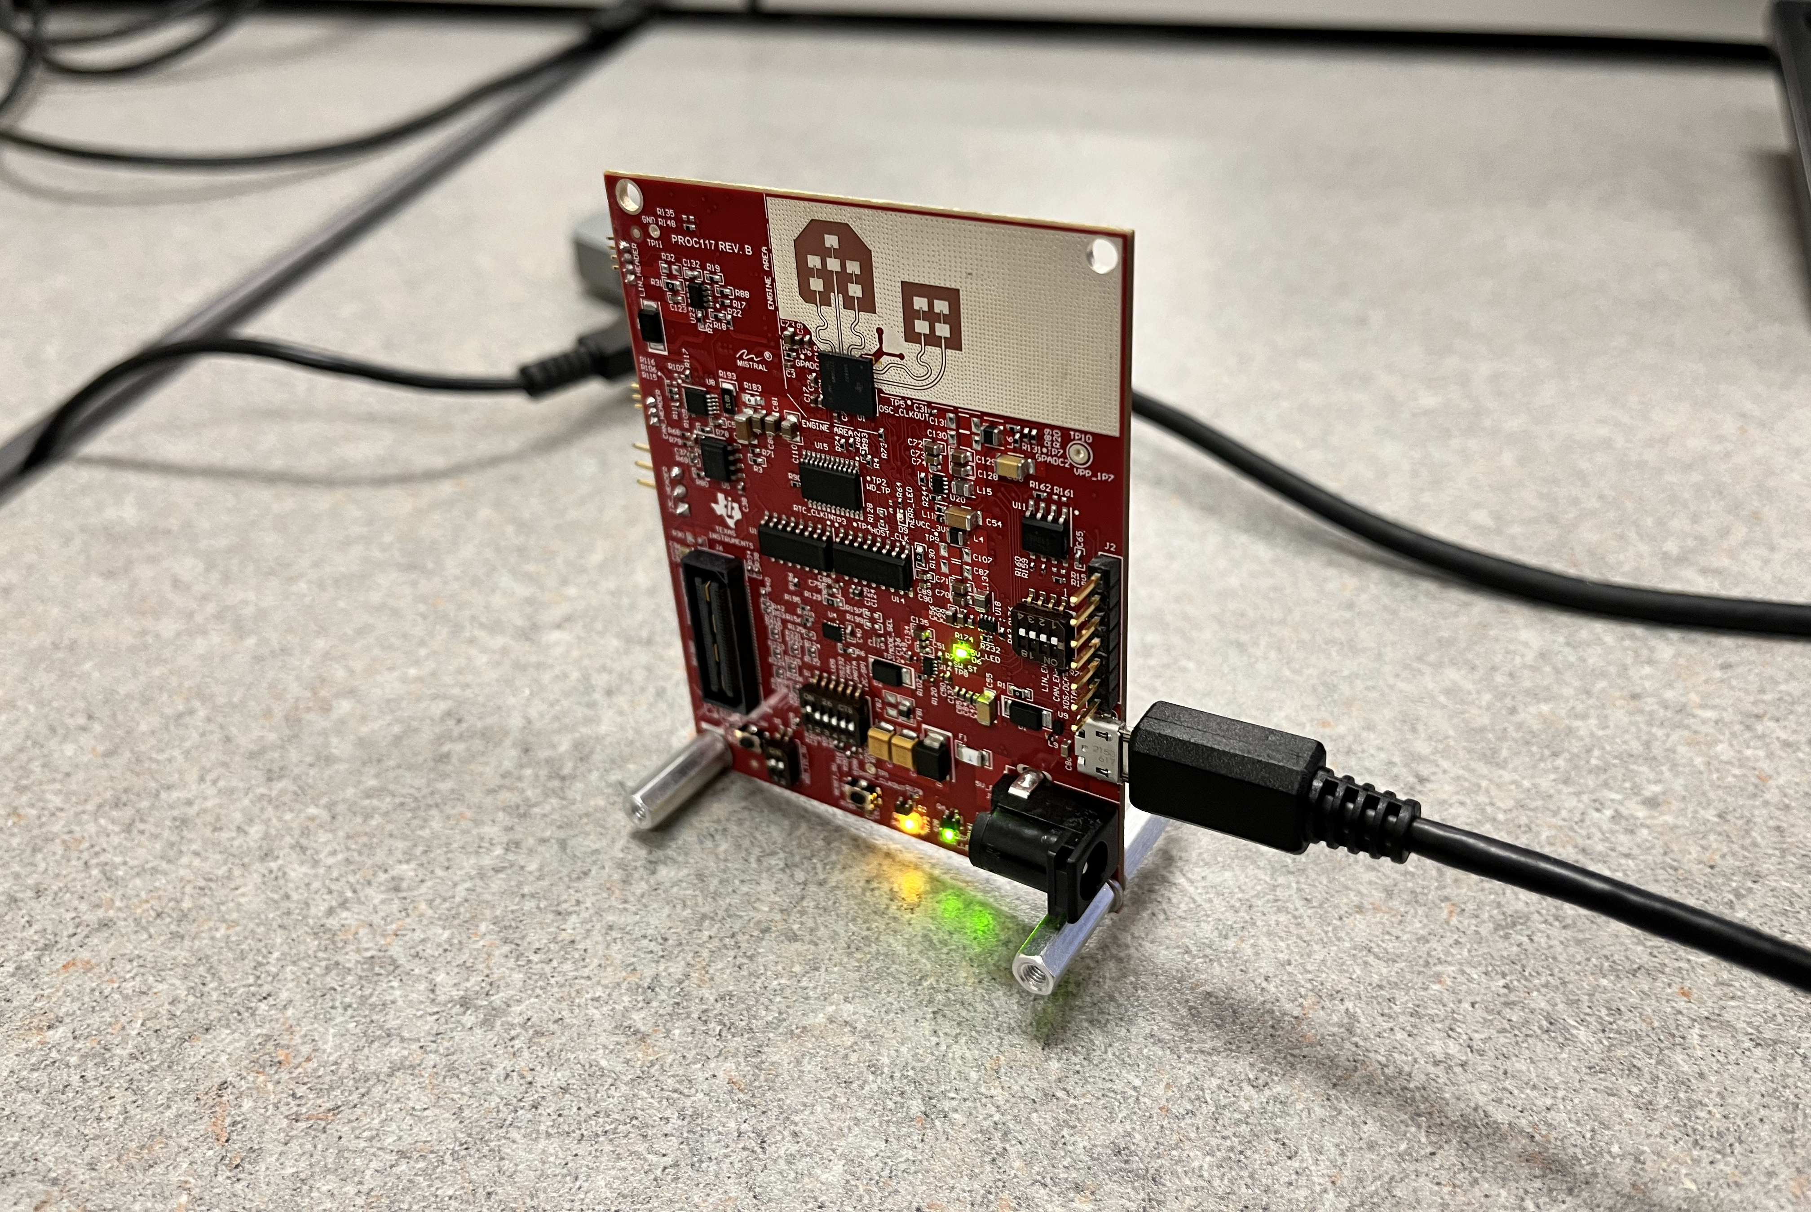
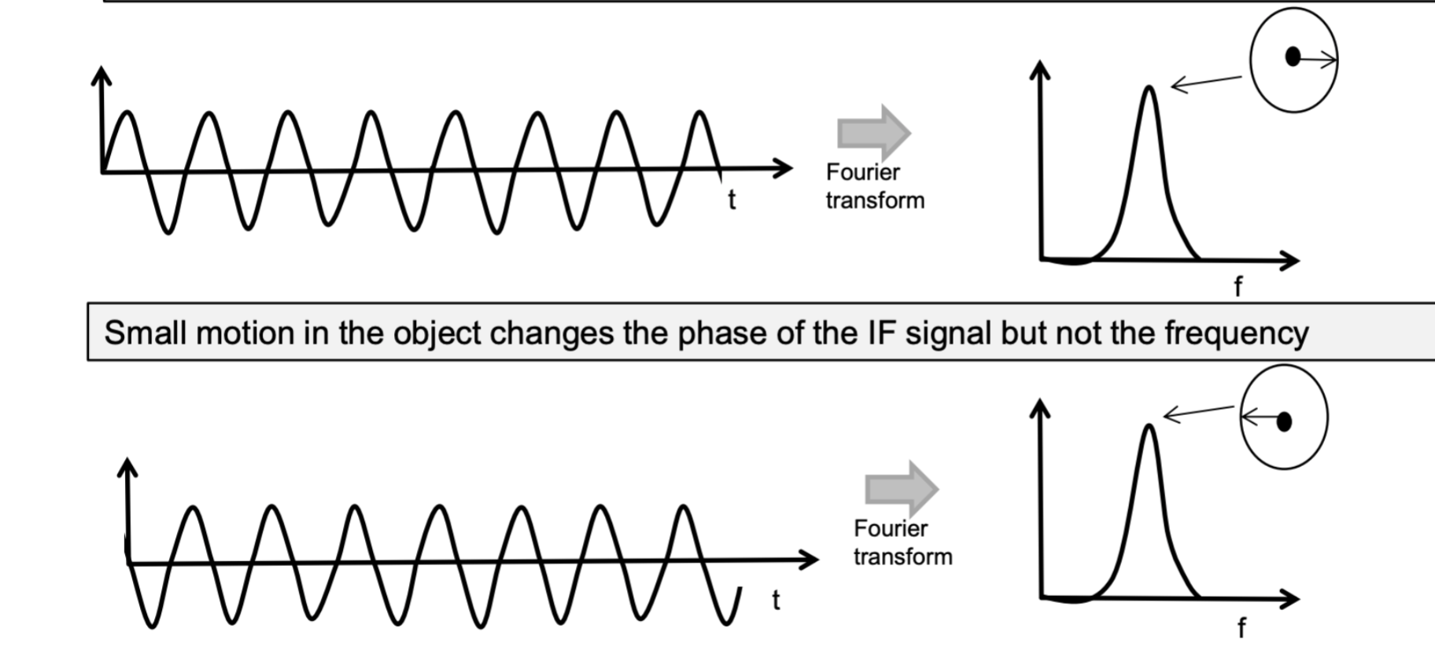
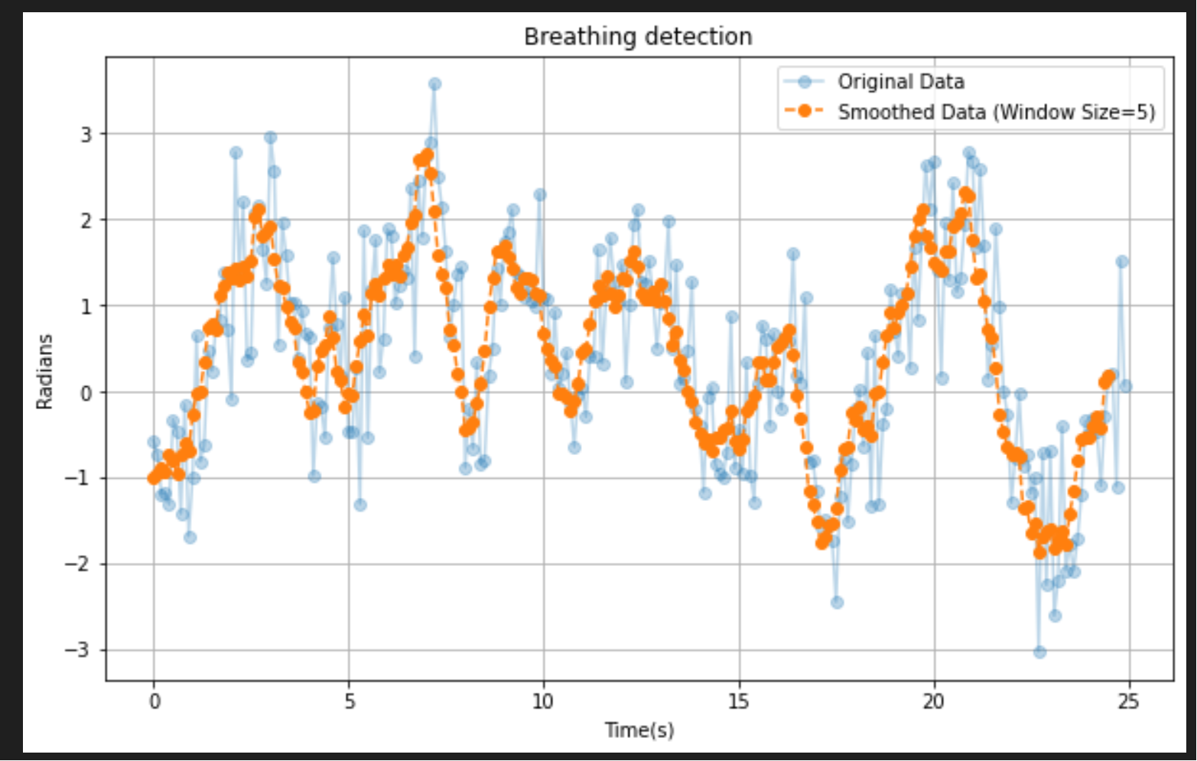
Respiratory Monitoring using Radar Signals
Dylan Bautista, Daniel Pogrebinsky
Topics in Internet of Things(CS 347 EKS), Department of Computer Science, University of Illinois Urbana-Champaign
Motivation: Wireless Vital Sign
Detection
Proposed Solution: Radar as a Sensor
Healthcare and smart homes are in demand for non-intrusive, accurate health monitoring solutions for patients.
Radar can be used to wirelessly detect torso micromovements related to breathing and collect data for rate analysis and anomaly detection.
Approach:
Radar placed at known distance collects raw ADC data.
This data is read and converted to Doppler profile using FFT for a specific range bin.
Challenges: Breath movements
are difficult to detect
Stomach expansion displacements are relatively small in comparison to radar range resolution bins.
Peaks are counted within smoothed data to
determine breathing behavior.
Place holder for Figure
Main Results
Recorded with error around ±1 breaths during 25 second period at fixed distance(4cm).
Results are reliant upon accuracy of fixed range bin, and ample movement of diaphragm.
Using raw ADC data to analyze phase changes can distinguish small displacements of IF signal and change the effective sensitivity.

